Slide 1


BE Project Presentation On “Using Deep Learning to Build An Accurate Integration and Differentiation System”
Presented by:
Student Name Roll No
1. Jeet Bardapurkar B150364240
2. Chaitanya Goski B150364317
3. Lomesh Game B150364307
4. Pooja Swami B150364507
Project Guide:
S.Y. Kulkarni

Slide 2
Outline
Introduction
Motivation
Problem Statement
Literature survey
Gap analysis
Objectives
System architecture
Algorithm
system diagrams
Mathematical model
System requirements
Results
Advantages
Limitations
Application
Conclusions
Future Work
References

Slide 3
Motivation
Symbolic calculation of functional integration and differentiation is a very complex problem
Difficult for both machines and humans to perform accurately and successfully.
Existing methods complex and unintuitive.

Slide 4
Introduction
Deep learning models achieve state-of-the-art performance in computer vision, speech recognition, natural language processing (NLP), etc.
Success of neural networks in symbolic computation still limited.
System considers mathematics, and particularly symbolic calculations, as a target for NLP models.
Use deep learning on two problems of symbolic mathematics: function integration and ordinary differential equations (ODEs).

Slide 5
Existing system uses a set of rules for calculus problems - explore a large number of specific cases and is complex.
Detecting patterns for calculus problems - may be easy for small expressions, but becomes more difficult as the number of operators increases.
To implement this, deep learning may help.

Slide 6
Problem Statement
Neural networks usually better at solving statistical or approximate problems than at performing calculations or working with symbolic data.
However, can be surprisingly good at more elaborate tasks in mathematics, such as symbolic integration and solving differential equations.
Using deep learning to perform accurate integration and differentiation.

Slide 7
Literature survey
Title | Description | Advantages | Disadvantages
Guillaume Lample, François Charton, Deep Learning for Symbolic Mathematics, https://arxiv.org/abs/1912.01412, 2019 | AI models can perform symbolic maths better than algebraic computer systems | This paper describes a comprehensive method to build AI models to perform symbolic maths | Even though it has better performance than algebra computer systems, the authors only recommend that the results from this system be verified
Miltiadis Allamanis, Pankajan Chanthirasegaran, Pushmeet Kohli, and Charles Sutton ,Learning continuous semantic representations of symbolic expressions, https://arxiv.org/abs/1611.01423, 2017 | new architecture for the problem of learning continuous algebraic and logical expressions | Neural equivalence networks, can effectively represent semantic equivalence, even of expressions that are very different | Changes in syntax can lead to very large changes in semantics, which can be difficult for continuous neural architectures.

Slide 8
Title | Description | Advantages | Disadvantages
Forough Arabshahi, Sameer Singh, and Animashree Anandkumar, Combining symbolic expressions and black-box function evaluations for training neural programs, https://arxiv.org/abs/1801.04342, 2018 | Neural programming involves training neural networks to learn programs, mathematics, or logic from data | This framework obtainins high accuracies and generalizes significantly better to expressions of higher depth and is able to fill partial equations with valid completions. | This is only applicable to the narrow area of function generalization and more research is needed.
Forough Arabshahi, Sameer Singh, and Animashree Anandkumar, Towards solving differential equations through neural programming, https://forougha.github.io/paperPDF/neuralODE.pdf, 2018 | goal is to take a step towards solving DEs through neural programming. Formally, Given a candidate solution to the differential equation | This paper proposes a generalizable and scalable neural solver for differential equations. | This paper does not talk about integration which is a more difficult problem

Slide 9
Title | Description | Advantages | Disadvantages
D. Bahdanau, K. Cho, and Y. Bengio, Neural machine translation by jointly learning to align and translate, https://arxiv.org/abs/1409.0473, 2015 | the neural machine translation aims at building a single neural network that can be jointly tuned to maximize the translation performance | This paper achieves a translation performance comparable to the existing state-of-the-art phrase-based system on the task of English-to-French translation | It is hard for this model to handle rare or unknown words.
Chris Dyer, Adhiguna Kuncoro, Miguel Ballesteros, and Noah A Smith, Recurrent neural network grammars, https://arxiv.org/abs/1602.07776, 2016 | efficient inference procedures that allow application to perform both parsing and language modelling | This paper provides better parsing in English than any previously published supervised generative model and better language modeling than state-of-the-art sequential RNNs in English and Chinese. | The system described here is difficult to understand and implement.

Slide 10
Title | Description | Advantages | Disadvantages
Akiko Eriguchi, Yoshimasa Tsuruoka, and Kyunghyun Cho, Learning to parse and translate improves neural machine translation, https://www.aclweb.org/anthology/P17-2012.pdf, 2017 | hybrid model, called NMT+RNNG, that learns to parse and translate by combining the recurrent neural network grammar into the attention-based neural machine translation. | This model learns to parse and translate simultaneously, and training it encourages both the encoder and decoder to better incorporate language. | This is designed for natural languages and not to apply on mathematical equations.
Sepp Hochreiter and Jurgen Schmidhuber, Long Short-Term Memory, https://direct.mit.edu/neco/article/9/8/1735/6109/Long-Short-Term-Memory, 1997 | A recurrent network architecture in conjunction with an appropriate gradient based learning algorithm | LSTM solves complex, artificial long time lag tasks that have never been solved by previous recurrent network algorithms much faster | LSTM take longer to train, take more memory and easy to overfit. It is also hard to apply dropouts to LSTM’s

Slide 11
Title | Description | Advantage | Disadvantage
Diederik P. Kingma, Jimmy Ba, Adam: A Method for Stochastic Optimization, https://arxiv.org/pdf/1412.6980v5.pdf, 2014 | an algorithm for first-order gradient-based optimization of stochastic objective functions, based on adaptive estimates of lower-order moments. | Adam is the default optimization algorithm currently and helps in faster gradient descent and it is more accurate than SGD. | Choosing a proper learning rate can be difficult. Also, it is easy to get trapped in local minima for highly non-convex error functions
Robert H. Risch, The solution of the problem of integration in finite terms., https://doi.org/10.1090/S0002-9904-1970-12454-5, 1970 | Elementary functions built up from the rational functions using only exponentiation, algorithms, trigonometric, inverse trigonometric and algebraic operations. | This paper gives the fixed algorithm to perform integration on a computer | The algorithm is very long and difficult to understand and implement.

Slide 12
Gap Analysis
Previous systems use fixed rules to solve the problems of integration and differentiation.
Even though these are accurate, these can be slow and difficult to perform.
This system will attempt to use deep learning to solve these types of problems.
Encoder-decoder model is used in this project which is usually only used in language translation.

Slide 13
Objectives
Using deep learning to build an accurate integration and differentiation system.

Slide 14
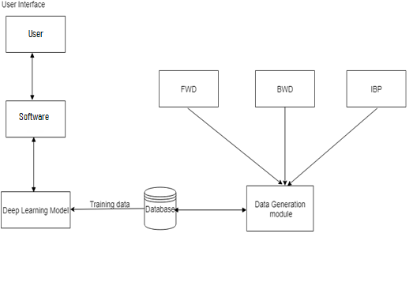
System Architecture

Slide 15
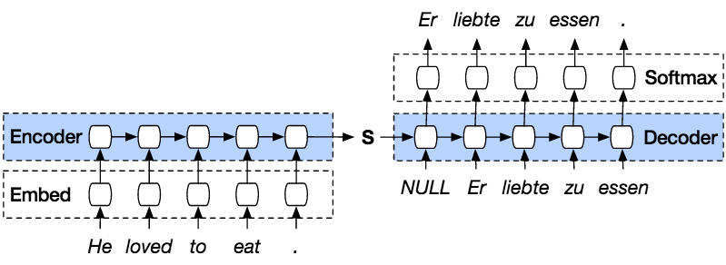
Algorithm
Seq2seq
a method of encoder-decoder based machine translation and language processing
maps an input of sequence to an output of sequence

Slide 16
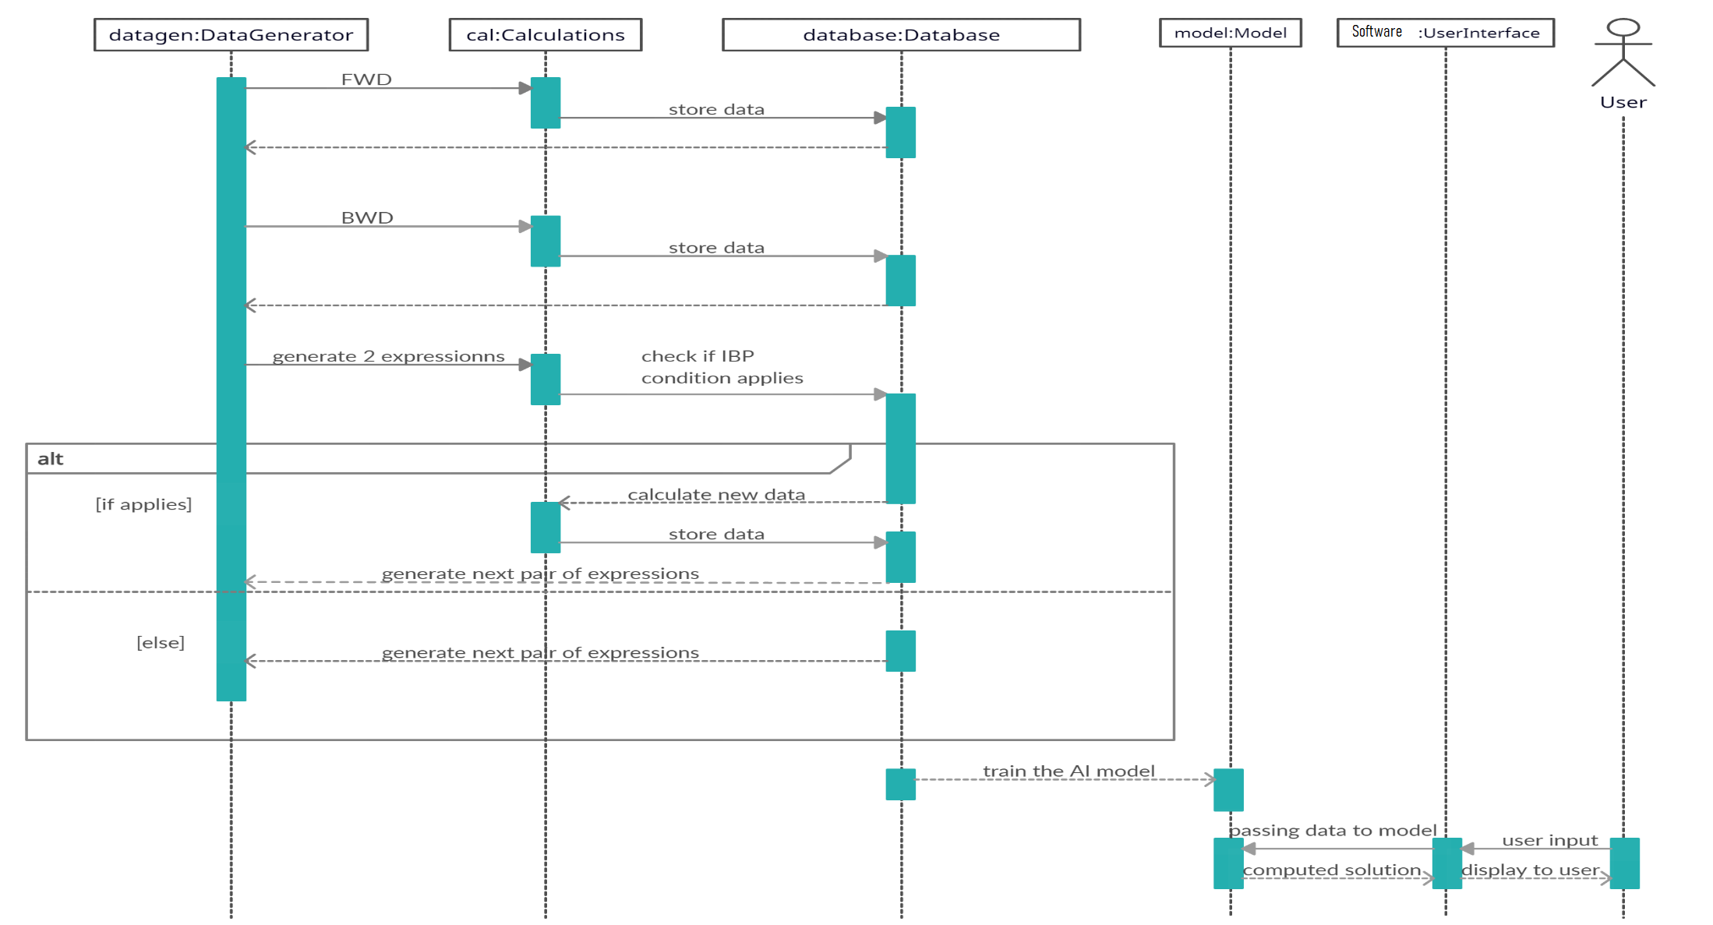
Sequence Diagram

Slide 17
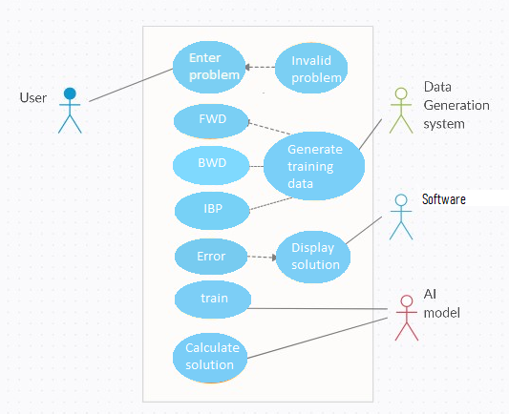
Use Case Diagram

Slide 18
Other diagrams available in this file

Slide 19
Mathematical model
System Description:
Input: Equation and operation to be performed from the user
Output: The resultant equation with the operation performed on the user’s equation
Mathematical Model :
S = (I,O,F)
Where,
F = f1,f2,f3,f4 –set of functions
I = i1,i2,i3-set of inputs
O = o1,o2---set of outputs
S: System.
I = F(i1, i2) – Inputs
where i1 : Input Equation, i2 : operation to be performed

Slide 20
F = F (f1 , f2 , f3) -Functions
Where f1 : Data Generation, f2 : training the model, f3: solving the problem
O = F(o1, o2) - Outputs
Where (a) o1 : Solution equation
Success Conditions: To perform the required operation on the input equation and give the correct answer to the user
(b) o2: Inaccurate result or error
Failure Conditions: The system gives an inaccurate solution or throws an error and is unable to give any solution

Slide 21
System Requirement
Hardware Interface: -
Processor - Intel i3 core
Speed - 1.1 GHz
RAM - 4GB
Hard Disk - 500 GB
Software Interface
Operating System - XP, Windows7/8/10
Coding language - Python
Database - File system

Slide 22
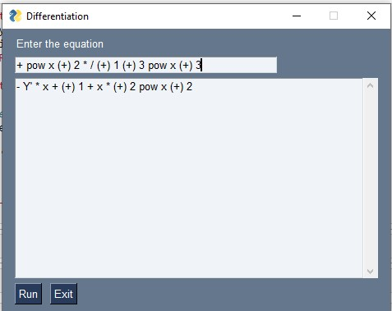
Results
This is the UI of the system.
Even though it doesn’t solve calculus problems in the expected way due to hardware limitations, the system is implemented completely and is able to run successfully and give output without error.

Slide 23
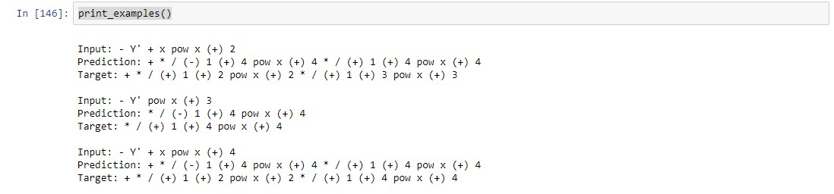
These are the best results from a previously trained model.

Slide 24
Advantages
System is intuitive and easy to understand
Helps to get quick solution to calculus problems
Easy to use
Has a very broad range of applications

Slide 25
Disadvantages
System needs almost 70 G.B. of data to train on which will take a lot of resources and expertise to implement
System may be unreliable for critical tasks
System cannot completely replace traditional computer algebra systems but complement them
Measuring correctness may be difficult since an equation can be represented in many different forms.

Slide 26
Applications
Education
Chemistry
Aviation
AI research
Mathematics

Slide 27
Conclusion
Functional differentiation and integration are challenging problems and we should apply new solutions to such problems.
An attempt was made at making one such solution with a new approach.

Slide 28
Future work
In the future, this system can be trained on a lot of data using professional level hardware and resources to make it actually usable.
Major computer algebra systems can implement this in their own systems to increase their speed and performance.
If the accuracy of this system increases high enough, it might even replace computer algebra systems as a standalone product

Slide 29
List of Publications
Name of the journal/conference: ICINC-2021 - 6th International Conference on Internet of Things, Next Generation Networks and Cloud Computing.
Comments of reviewers: Received the award for “Best Paper”, reviewer said the concept is fresh and creative, advised to train on more data if/when sufficient hardware becomes available.

Slide 30
Reference
Guillaume Lample, François Charton, “Deep Learning for Symbolic Mathematics”, arXiv:1912.01412, 2 December 2019
Miltiadis Allamanis, Pankajan Chanthirasegaran, Pushmeet Kohli, and Charles Sutton. Learning continuous semantic representations of symbolic expressions. In Proceedings of the 34th International Conference on Machine Learning - Volume 70, ICML’17, pp. 80–88. JMLR.org, 2017.
Forough Arabshahi, Sameer Singh, and Animashree Anandkumar. Combining symbolic expressions and black-box function evaluations for training neural programs. In International Conference on Learning Representations, 2018a.
Forough Arabshahi, Sameer Singh, and Animashree Anandkumar. Towards solving differential equations through neural programming. 2018b.
D. Bahdanau, K. Cho, and Y. Bengio. Neural machine translation by jointly learning to align and translate. In International Conference on Learning Representations (ICLR), 2015.

Slide 31
M. Bronstein. Symbolic Integration I: Transcendental Functions. Algorithms and combinatorics. Springer, 2005. ISBN 978-3-540-21493-9.
Chris Dyer, Adhiguna Kuncoro, Miguel Ballesteros, and Noah A Smith. Recurrent neural network grammars. In Proceedings of the 2016 Conference of the North American Chapter of the Association for Computational Linguistics: Human Language Technologies, pp. 199–209, 2016.
Akiko Eriguchi, Yoshimasa Tsuruoka, and Kyunghyun Cho. Learning to parse and translate improves neural machine translation. In Proceedings of the 55th Annual Meeting of the Association for Computational Linguistics (Volume 2: Short Papers), pp. 72–78, 2017.
Philippe Flajolet and Andrew M. Odlyzko. Singularity analysis of generating functions. SIAM J. Discrete Math., 3(2):216–240, 1990.
Philippe Flajolet and Robert Sedgewick. Analytic Combinatorics. Cambridge University Press, New York, NY, USA, 1 edition, 2009. ISBN 0521898064, 9780521898065.

Slide 32
THANK YOU

